Slide 1
ENSE 400
Bi-Weekly Scrum Report-Out
[Group name]
[Group members]
[Date of report-out]

Slide 2

Project deats
Remind me what you are doing
  What problem(s) are you trying to solve?
  What gap are you filling?
  What innovation are you creating?

Slide 3

Project & documentation review
What are you currently working on?
“Show me what you got” (including but not limited to…)
  Problem definition & requirements documentation/work
    Vision, Rationale, Stakeholders, Assumptions, Constraints
    Functional requirements
  Picturing (software) architecture documentation/work
    High-level architecture pics (e.g. Kanban, USM, Gantt, etc.?)
    Low(er)-level architecture pics (e.g. interaction, data, context class, UI/UX (lo/hi fidelity prototyping), etc.)
  Code
  Testing plans/work
    Code
    Usability
  Deployment/change management plan/work
  Maintenance & refactoring plan/work
GitHub/Version control “stamp of approval”
  Is it readable, usable, does your team confirm its “goodness”?

Slide 4
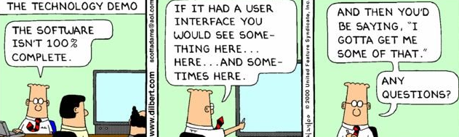
Project demo
If available, demo what you got running
Include screenshots here as well

Slide 5

Group reflection
Do you feel you are on track?
  [Response here]
Do you feel there are barriers to your success (if any)?
  [Response here – Go beyond “time” or “we’re busy”]
    Time is limited for everyone and everyone is busy
    Such is the life of a SSE’er
Do you need any help going forward?
  [Response here]
Any other questions or concerns?
  [Response here]

Slide 6
Image refs
Show me what you got, https://pictures.abebooks.com/isbn/9781548899530-us-300.jpg
Patrick, https://imgflip.com/memetemplate/43274976/spongebob-patrick-nail-saw
Dilbert, http://4.bp.blogspot.com/-tVbJsudDNaw/T29WxQ0PHZI/AAAAAAAAABc/UlTwD2gkzA4/s1600/Dilbert%2520Software%2520Demo%5B1%5D.jpg
Pondering, https://imgflip.com/s/meme/Question-Rage-Face.jpg

